Slide 1
Picture This!
Vicky Neale
Mathematical Institute & Balliol College, University of Oxford
vicky.neale@maths.ox.ac.uk, @VickyMaths1729

Slide 2
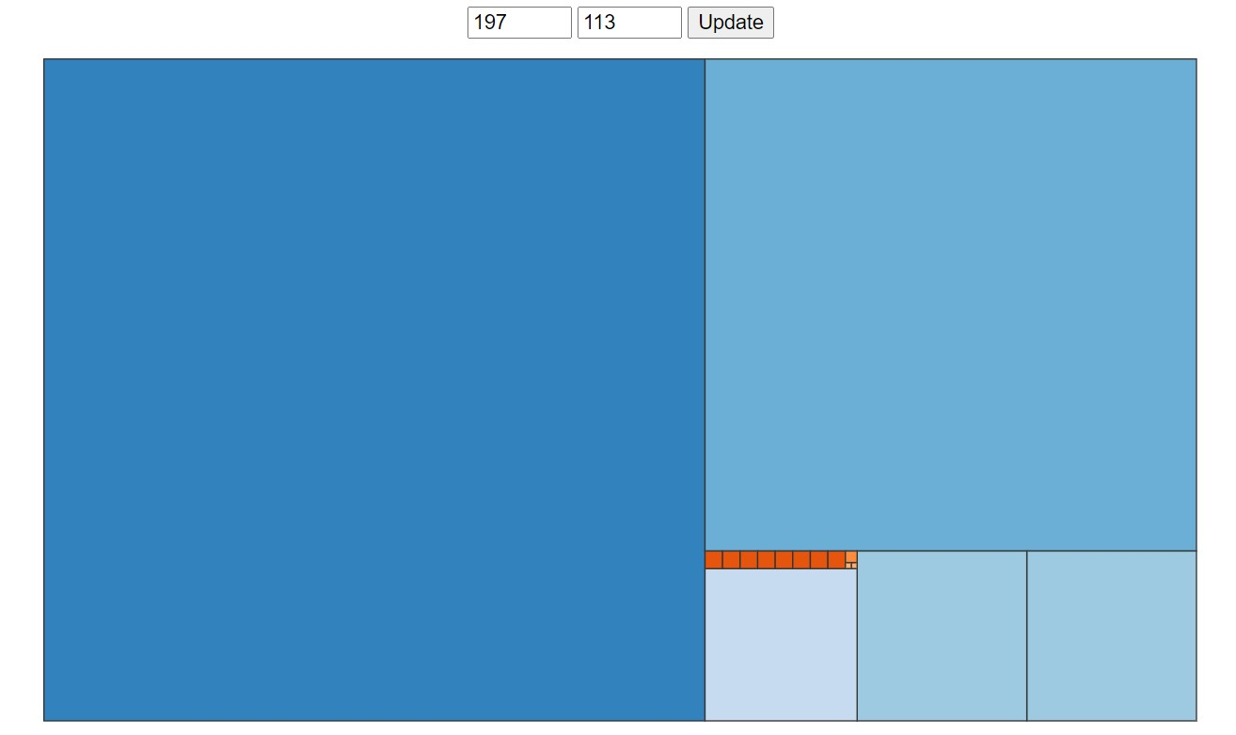

Slide 3
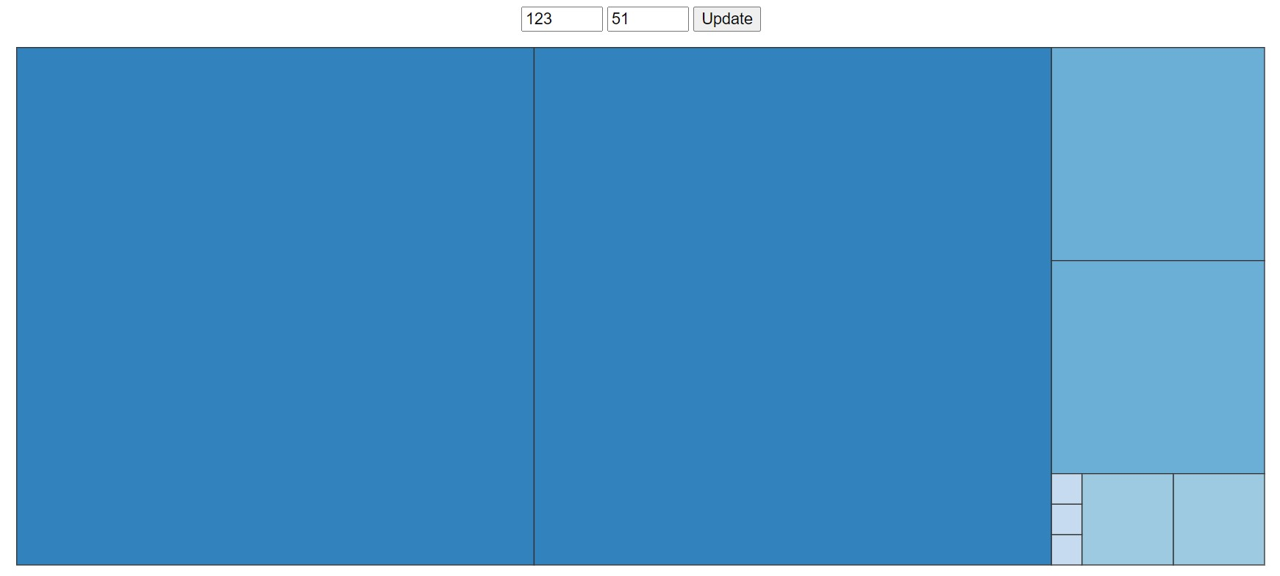

Slide 4
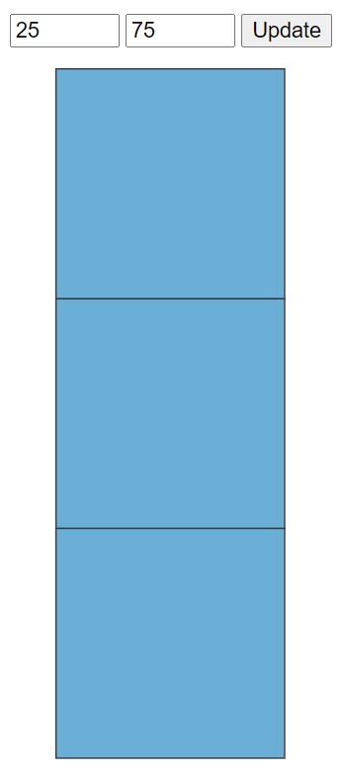

Slide 5
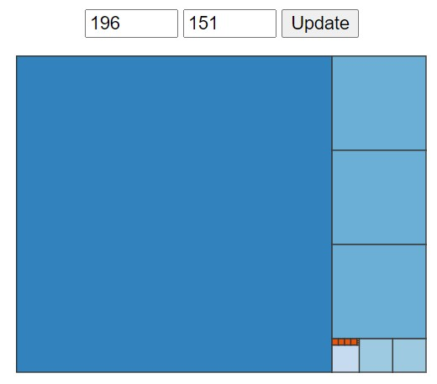

Slide 6
Key questions
Given two numbers, can you draw the corresponding diagram?
Given a diagram, can you find the corresponding two numbers?

Slide 7
Can you draw the diagram for the pair of numbers 127, 105?

Slide 8
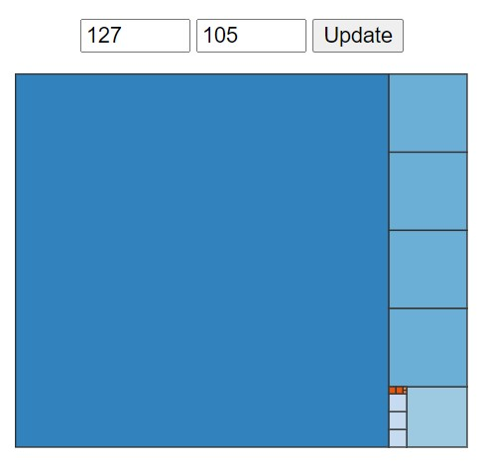

Slide 9
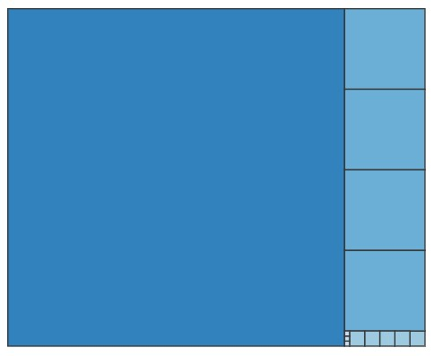
Here’s a diagram, can you find the numbers?

Slide 10
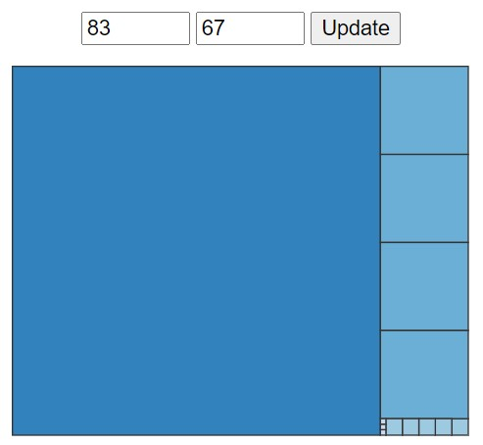

Slide 11
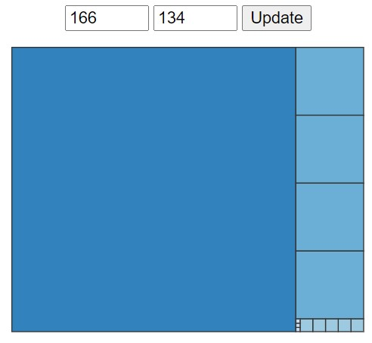

Slide 13
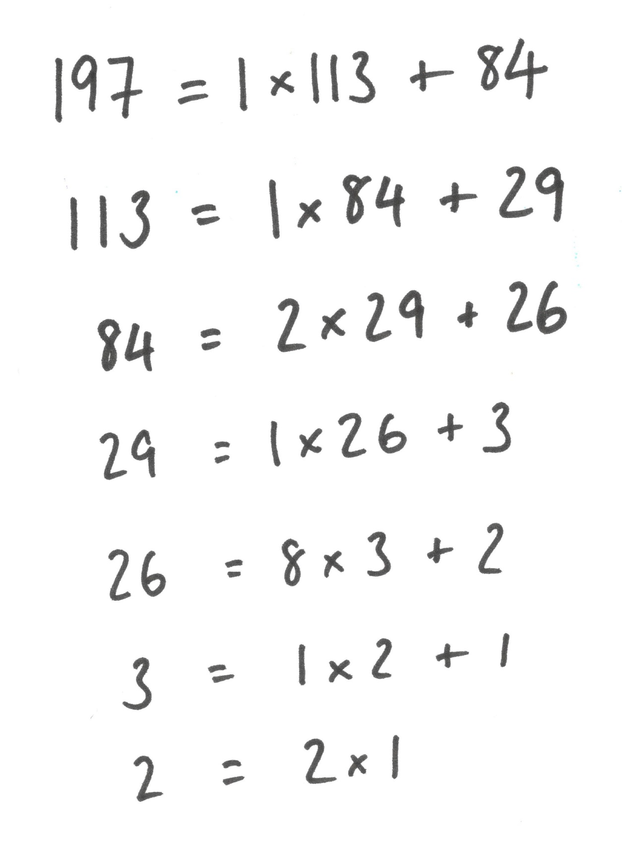

Slide 21
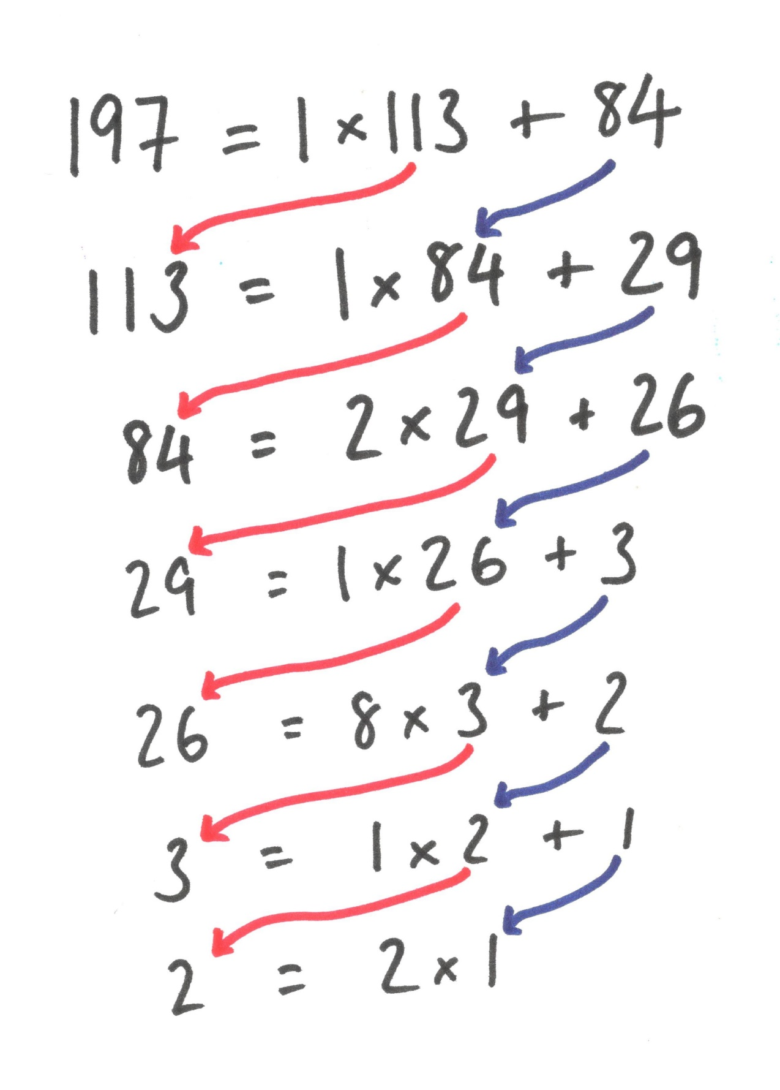

Slide 22
You can explore for yourself
https://nrich.maths.org/psum/picture-this/

Slide 23
Conjecture: the side length of the smallest square (the last nonzero remainder) is the highest common factor of the two starting numbers.

Slide 24
To show that a number is the highest common factor of a and b, we need to show:
that it is a common factor – it divides both a and b
that it’s the highest – any common factor is less than or equal to it.

Slide 26
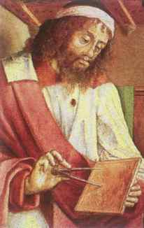
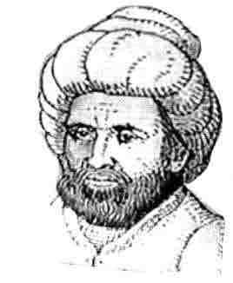
Euclid’s algorithm
Euclid (325BCE—265BCE, maybe)
Al-Khwarizmi (780-850, maybe)

Slide 27
If you’d like to explore further…
https://nrich.maths.org/psum/picture-this/
Search for “Euclid’s algorithm” or the “Euclidean algorithm”
Consult your favourite introductory number theory book. Mine is The Higher Arithmetic by Davenport (Cambridge University Press).

